Slide 1
IOT BASED ALERT SYSTEM ON A PROCESS FAILURE
PRESENTED BY
P ASHOK SIVA KUMAR

Slide 2
OBJECTIVE
The Objective of the project is to notify status of a remote process via Alarm or Flash Screen.

Slide 3
V-GATE PROCESS
Followed each Phase from V-Gate with proper documentation.
Define, Specify, Architecture, Design, Implementation, validate

Slide 4
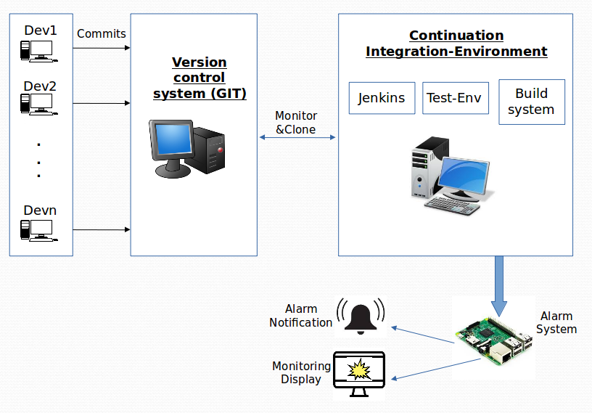
ARCHITECTURE & DESIGN DIAGRAM

Slide 5
PROJECT DESCRIPTION
&
ENVIRONMENT
To monitor a remote process where integration and building is continuous with upgradations and updations.
To Alert people who are monitoring the remote process when a build fails with the new integration.
Alerts via Sound or Flash on the Screen

Slide 6
ROLES & RESPONSIBILITIES
Jenkin’s Server set up.
Application Development.

Slide 7
THANK YOU.....

Slide 8
Thank You............

